Slide 1
Progress Report 1
Innovation in Engineering

Slide 2
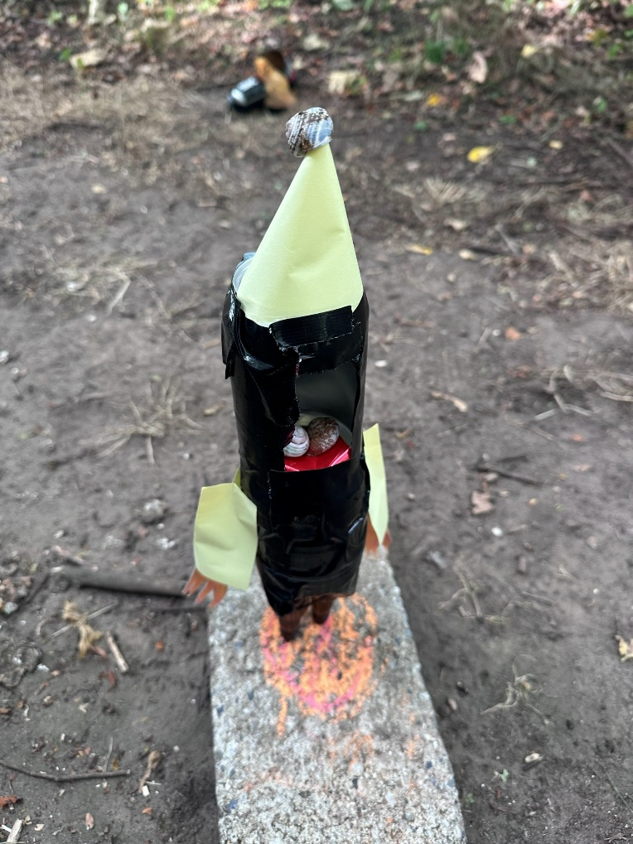
Part 1
DTU Course:
Innovation in Engineering
Goal: Reflect on your role within the team concerning:
What potential role and contribution would you like to experience and deliver to gain the most from the course?
How do you align yourself with and play into the team’s expectations and performance?
Consider: Team communication, time management expectations, adjustment for the next time, Conflict Resolution, and Decision-Making.
Student name: Hákon Hlynsson
Student nr.: S225765
The role I was given in the personality test was "Executive", meaning I am the kind of person who likes a structured setup with clearly defined goals, enjoys efficient, no-nonsense work, and has a strong sense of responsibility.
Throughout this course, I would like to explore the role of an organiser and driver within the team, as someone who takes responsibility for planning, sets clear milestones, and makes sure we actually deliver on what we agree. I believe this is where I can contribute most, but I also see that this might create problems for the innovation process, since innovation takes time and is not something you can push through. This is something I will keep in mind throughout the entire course.
Insert Image
Insert Image

Slide 3
Part 2
DTU Course:
Innovation in Engineering
Goal: Reflect on your role within the team concerning:
What potential role and contribution would you like to experience and deliver to gain the most from the course?
How do you align yourself with and play into the team’s expectations and performance?
Consider: Team communication, time management expectations, adjustment for the next time, Conflict Resolution, and Decision-Making.
Student name: Hákon Hlynsson
Student nr.: S225765
To align myself with the team's expectations, I will follow the established group contract regarding our communication channel (WhatsApp), deadlines, and how we divide tasks. Regarding time management, I will show up prepared and on time (9:00 if nothing else is planned), and I expect the same from others, unless something else has been agreed.
If conflicts arise, my instinct as an "Executive" is to solve them quickly and directly. I see the value in that, but I want to make sure conflicts are resolved fairly, where everyone's perspective is heard. When making decisions, I will push for choices based on clear criteria, while ensuring all team members actively participate in the discussion. I will consider my work a success if we as a team deliver a project that everyone has contributed to and is proud to be a part of.
Insert Image
Insert Image

